Slide 1

Experiential Learning Project Assessment-I on
“Dice Rolling Simulator”
under the course
Python Programming Language (N-PCCCM304P)
Under the Guidance of
Ms. Suchita Meshkar
Presented By
Kanak S. Shahu
CM25022
Session:2026-27 (ODD )
Department of CSE(AI&ML)
S. B. JAIN INSTITUTE OF TECHNOLOGY MANAGEMENT AND
RESEARCH,NAGPUR
An Autonomous Institute, Affiliated to RTMNU, Nagpur
)

Slide 2
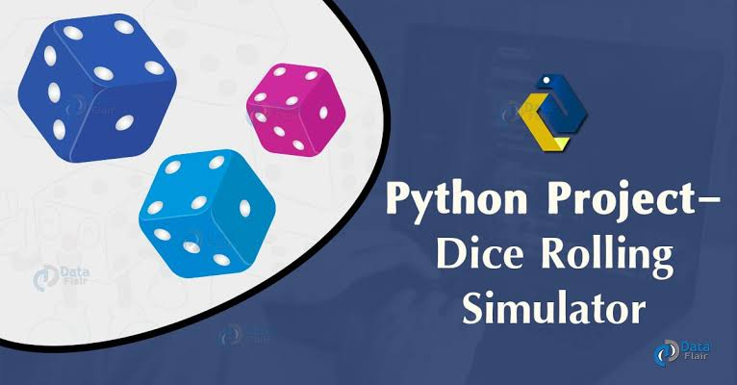
Contents
Problem statement
Objectives
Algorithm
Flowchart/pseudocode
Understanding of Python logic
GitHub account, repository creation, uploading code, meaningful commits, collaboration, individual contribution
S. B. Jain Institute of Technology Management and research

Slide 3
Problem Statement :
Dice Rolling Simulator:
Develop a Python-based Dice Rolling Simulator that mimics the rolling of one or more dice. The application should generate random numbers between 1 and 6 to simulate the outcome of rolling a standard six-sided die. Users should be able to roll the dice multiple times, view the results, and optionally maintain a history of previous rolls. The project should provide an interactive and user-friendly interface while demonstrating the use of Python's randomization techniques, loops, functions, and exception handling.

Slide 4
Objectives :
To make a program using Python that acts like a real dice.
To generate random numbers between 1 and 6, just like a real six-sided dice.
To let the user roll the dice as many times as they want.
To show the result of each roll to the user.
To keep a record (history) of all the rolls done so far, if the user wants to see it.
To learn and use basic Python ideas like loops, functions, random numbers, and exception handling (handling wrong inputs).
To build a simple menu so the user can choose what to do (roll dice, see history, or exit).

Slide 5
Algorithm :
Step 1: Start the program.
Step 2: Create an empty list to store the history of rolls.
Step 3: Show a menu to the user with options:
Roll the dice
View roll history
Exit the program
Step 4: Ask the user to enter their choice.
Step 5: If the user chooses "Roll the dice":
Generate a random number between 1 and 6.
Show this number to the user as the result.
Add this number to the history list.

Slide 6
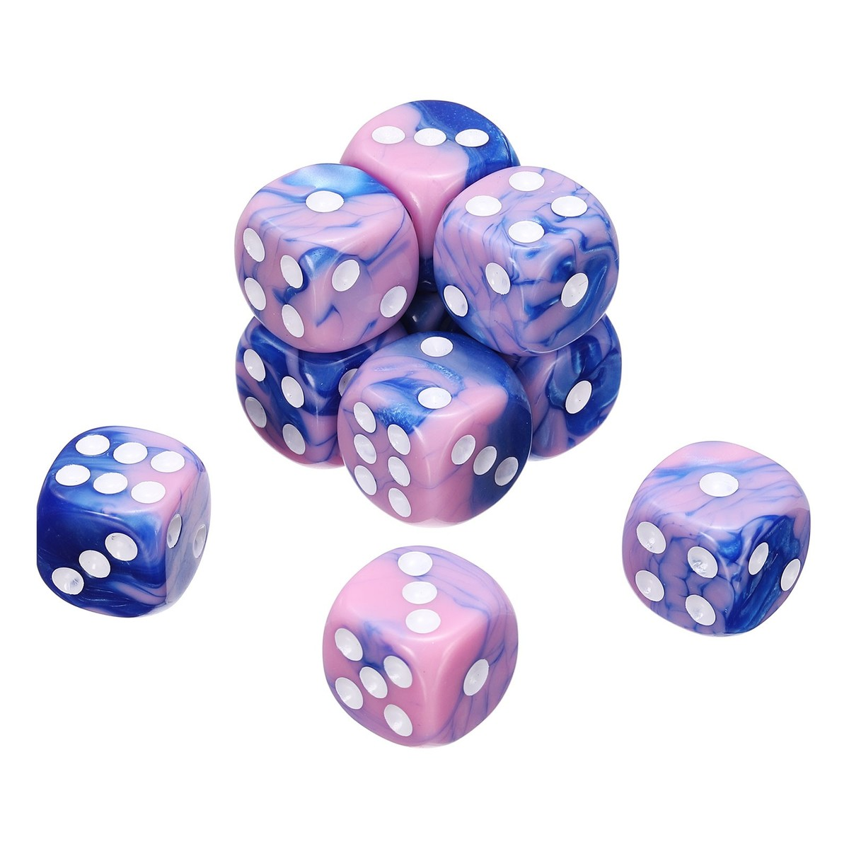
Step 6: If the user chooses "View history":
Show all the numbers stored in the history list so far.
Step 7: If the user enters a wrong choice (not 1 to 6):
Show an error message and ask again (this is exception handling)
Step 8: If the user chooses "Exit":
Stop the program.
Step 9: Repeat Steps 3 to 8 until the user chooses to exit.
Step 10: End the program.

Slide 7
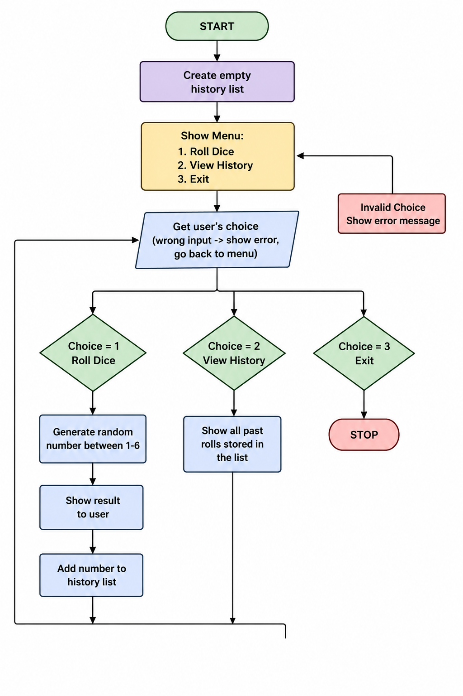
Flowchart :

Slide 8
Python Logic Used :
1. Random numbers
Python has a tool called random. We use random.randint(1, 6) to get a random number between 1 and 6. This is how the computer "rolls" the dice.
2. Loop
We use while True: so the program keeps running again and again, showing the menu every time, until the user says stop.
3. Function
We put the dice-rolling steps inside one function, like roll_dice(). This way we write it once and use it as many times as we want.
4. List (for history)
A list is like a box that can hold many items. Every time the dice is rolled, we add the number to this list using history.append(number). This is how we remember all past rolls.
5. Try and except (handling wrong input)
If the user types something wrong, like letters instead of numbers, the program would normally crash. try and except let the program catch this mistake and show a simple message instead of crashing.

Slide 9
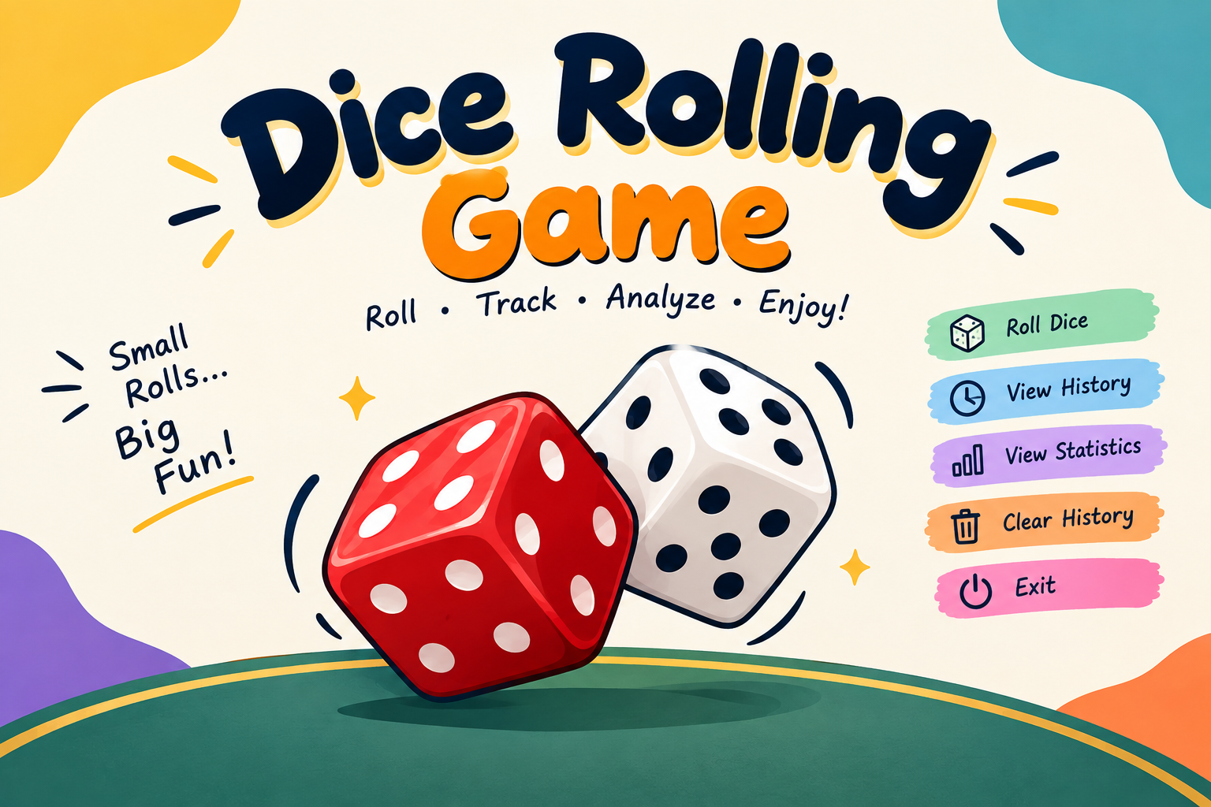
DICE ROLLING STIMULATOR
LEVEL - 2

Slide 10
Changes made :
Functions instead of one big block
Earlier, all the code was directly inside the loop. Now I broke it into separate functions — roll dice(), show history(), show statistics(), clear history(). Each function does one job. This makes the code easier to read and easier to fix later.
Roll many dice at once, not just one
Before, every roll gave only 1 number. Now the program asks "how many dice do you want to roll?" and rolls that many dice together using a loop. This is closer to how a real dice game works (like rolling 2 or 3 dice at once).
3. Statistics option (new menu item)
I added a new option that shows:
Total number of rolls done so far
The highest number rolled
The lowest number rolled
The average of all rolls
How many times each number (1 to 6) has appeared
This uses simple Python tools: max(), min(), sum(), and .count().

Slide 11
4. Clear history option (new menu item)
Now the user can empty the history list anytime using history.clear(), instead of it just growing forever.
5. Menu grew from 3 options to 5 options
Old menu: Roll / History / Exit
New menu: Roll / History / Statistics / Clear History / Exit
6. Input checking added in one more place
Along with checking the menu choice, we now also check the number of dice entered, so the program doesn't roll 0 or negative dice by mistake.

Slide 12
Algorithm :
1. Start
2. Import the random module.
3. Create an empty list called history to store all dice rolls.
4. Display the menu:
  Roll Dice
  View History
  View Statistics
  Clear History
  Exit
5. Read the user's choice.
6. If the choice is 1 (Roll Dice):
  Ask the user for the number of dice.
  Check whether the number is greater than 0.
  Generate a random number from 1 to 6 for each die.
  Store the results in history.
  Display the rolled numbers.

Slide 13
7. If the choice is 2 (View History):
  Check whether the history is empty.
  If empty, display "No rolls yet."
  Otherwise, display all previous rolls.
8. If the choice is 3 (View Statistics):
  Check whether the history is empty.
  Calculate total rolls, highest roll, lowest roll, and average.
  Count how many times each number from 1 to 6 appeared.
  Display the statistics.
9. If the choice is 4 (Clear History):
  Clear all values from history.
  Display "History cleared."
10. If the choice is 5 (Exit):
  Display "Goodbye!"
  Stop the program.
11. If an invalid choice or non-numeric input is entered, display an appropriate error message.
12. Repeat the menu until the user selects Exit.
13. Stop.

Slide 14
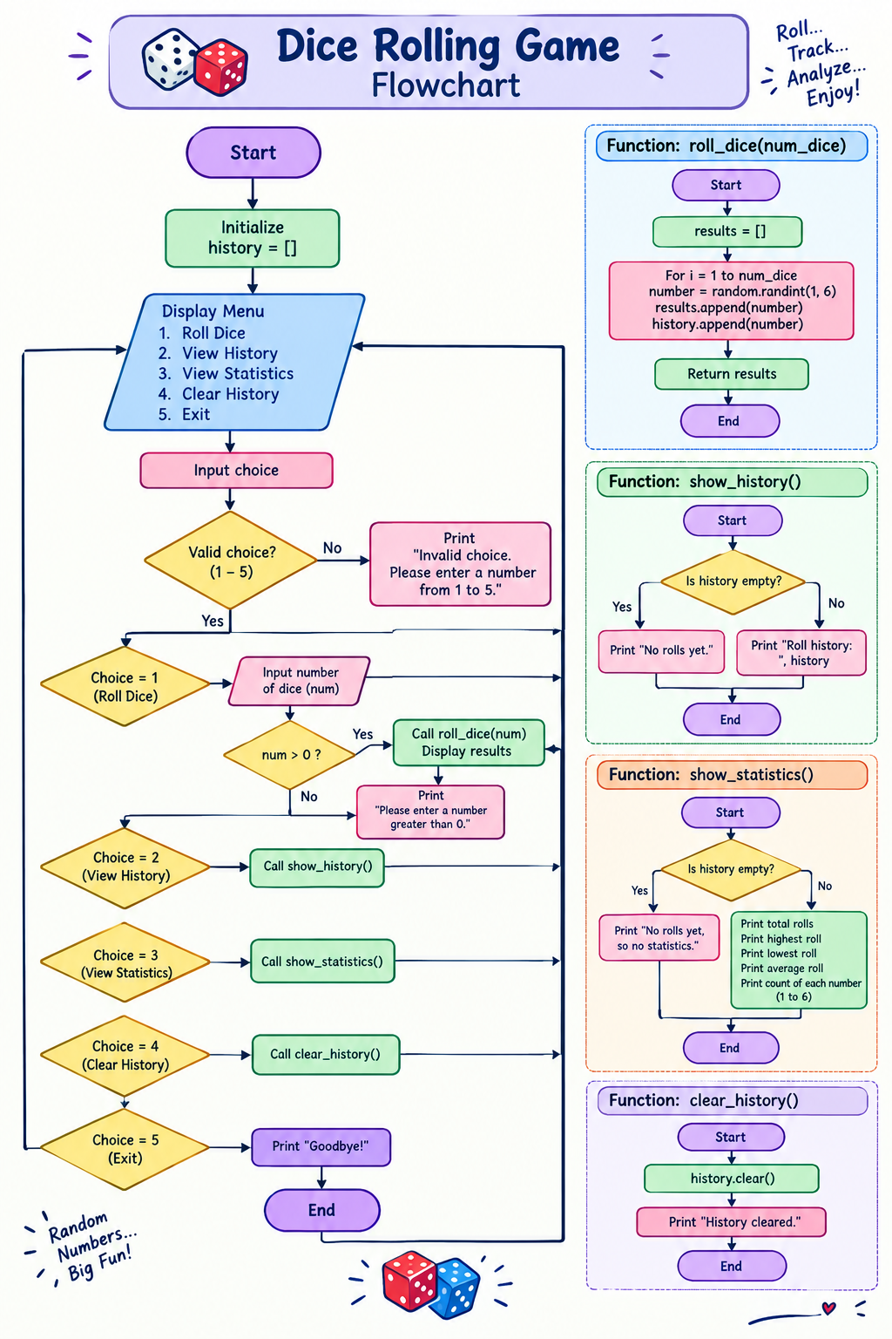

Slide 15
Thank You
S. B. Jain Institute of Technology Management and research

